Slide 1

Medical Cost Personal Dataset (Group 15)
By,
Shashikant Yadav (1st Speaker)
Bhargav Kumar (2nd Speaker)
Suresh Gopal (3rd Speaker)

Slide 2

Importing Libraries

Slide 3

Data Preparation

Slide 4
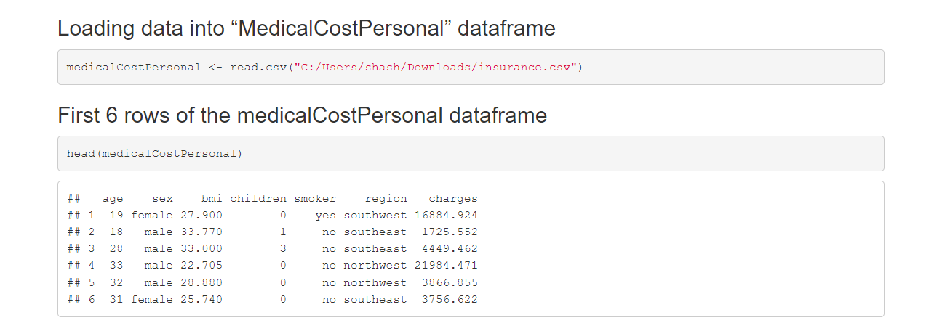
medicalCostPersonal Dataset

Slide 5
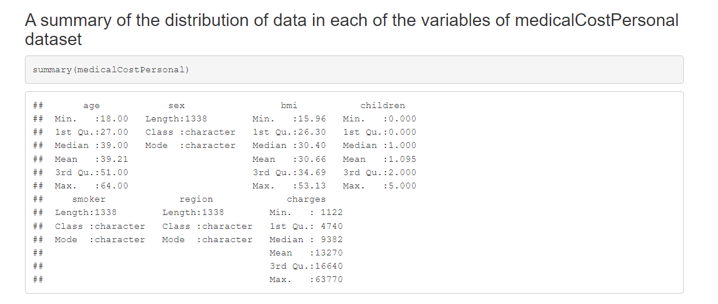
Summary

Slide 6
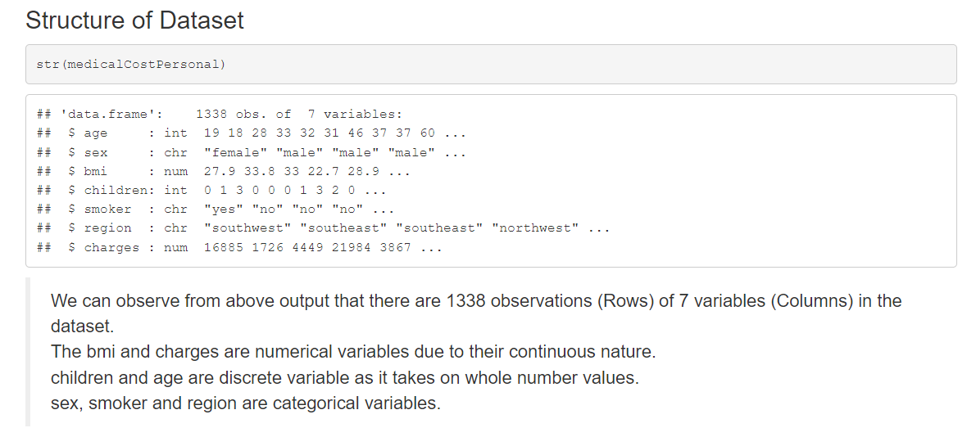
Structure

Slide 7

Anomaly Check 1

Slide 8

Anomaly Check 2

Slide 9

Anomaly Check 3

Slide 10

Anomaly Check 4

Slide 11

Anomaly Check 5

Slide 12
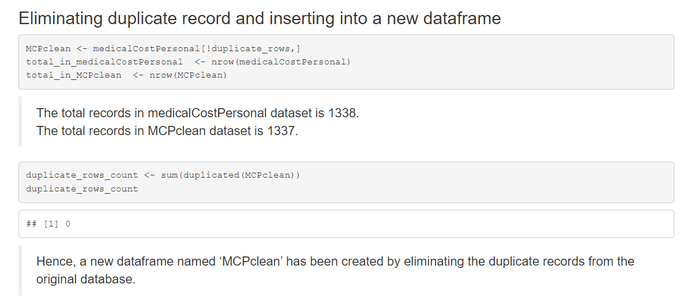
Eliminating Duplicate Record

Slide 13
Exploratory Data Analysis (EDA)

Slide 14
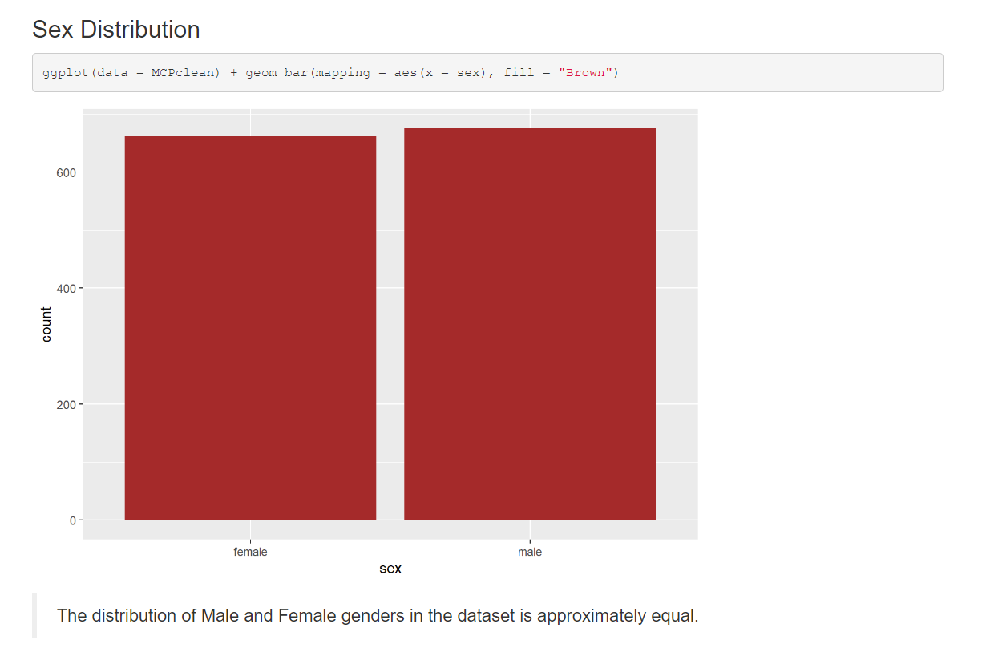
Sex Distribution

Slide 15
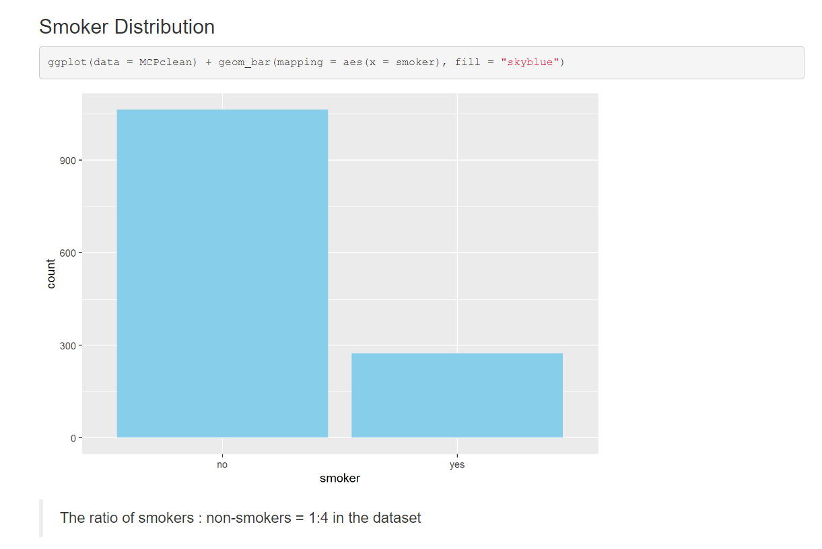
Smoker Ditribution

Slide 16
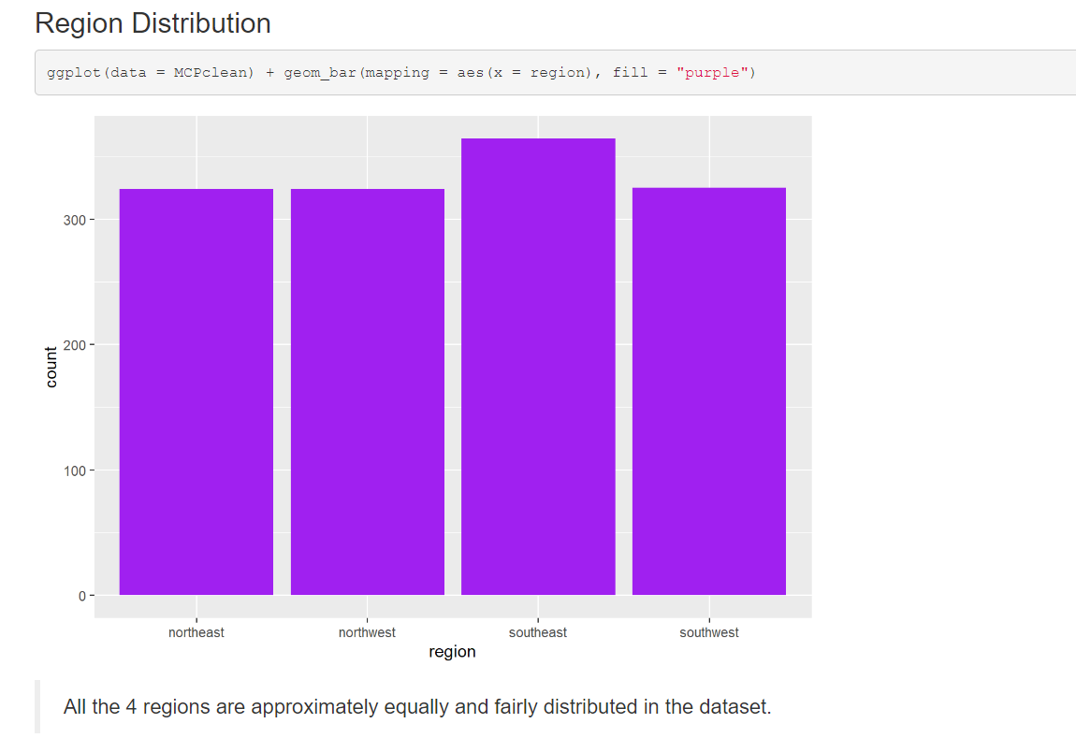
Distribution by Region

Slide 17
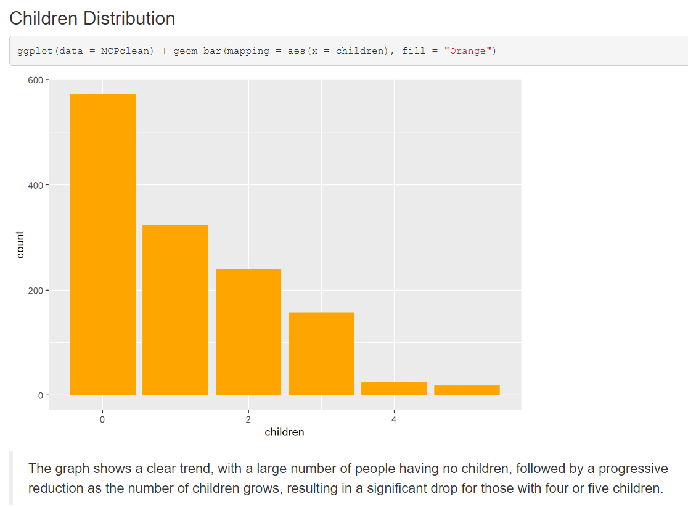
Distribution by Children

Slide 18
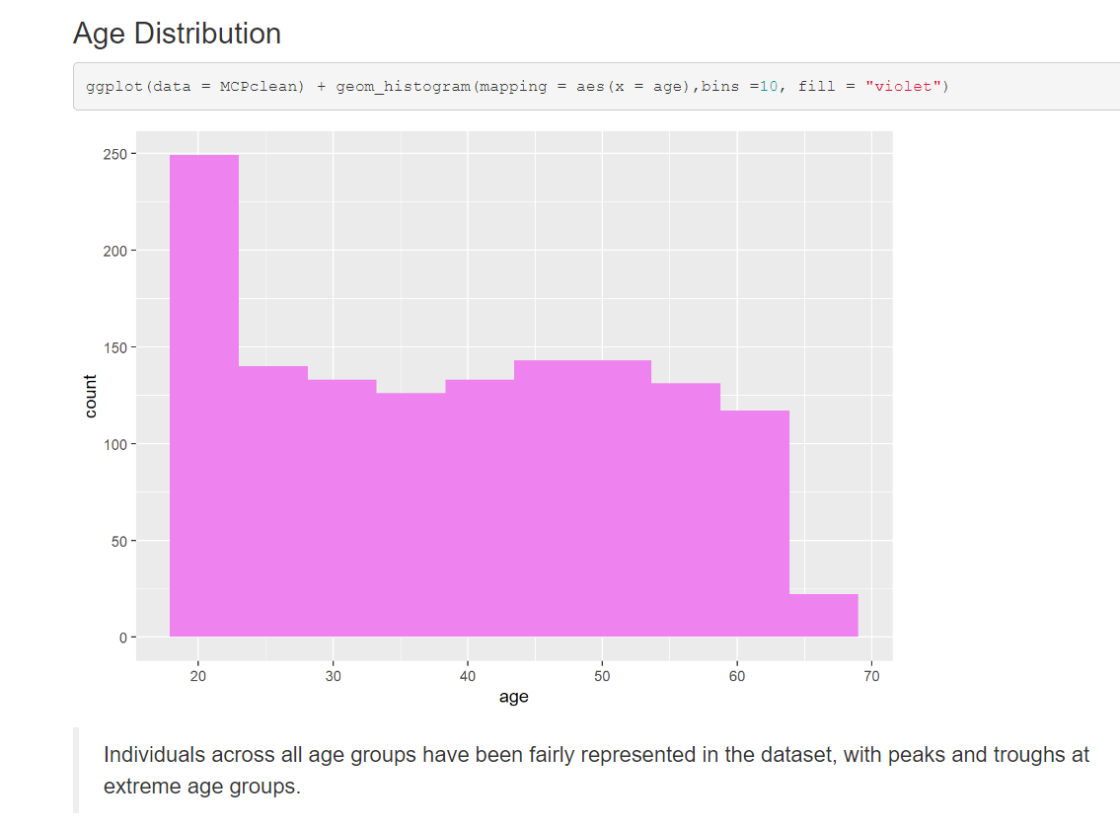
Distribution by Age

Slide 19
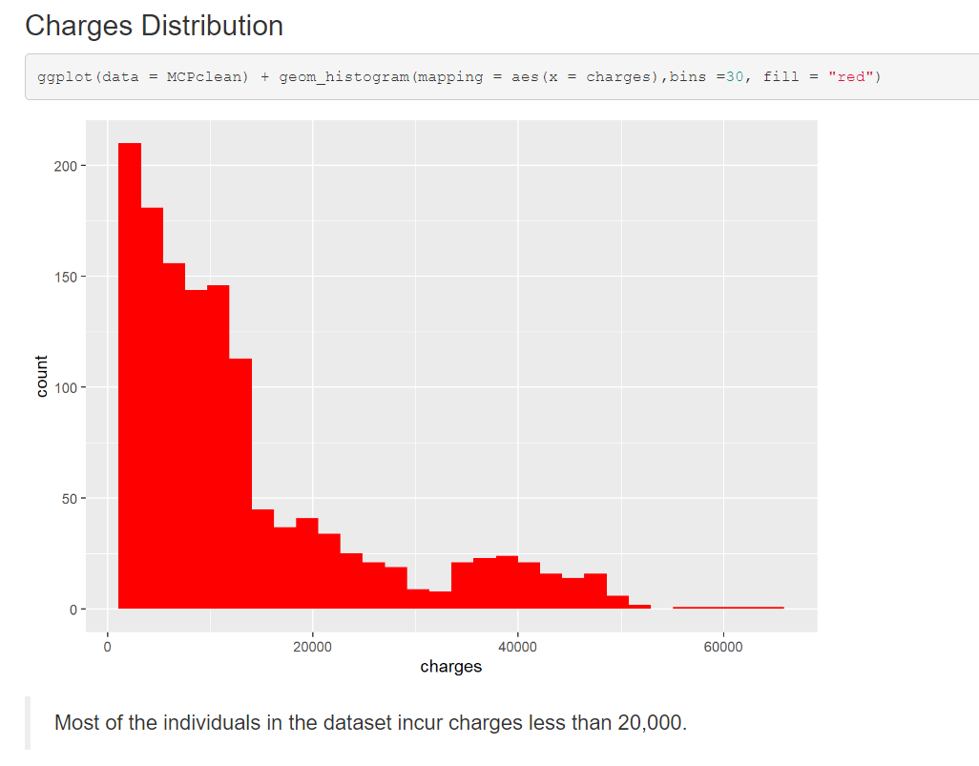
Distribution by Charges

Slide 20
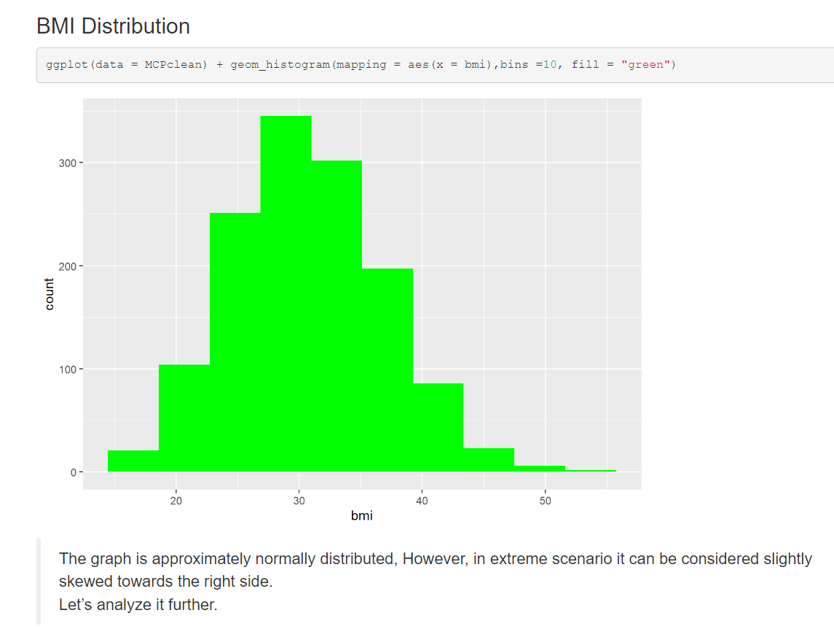
Distribution by BMI

Slide 21
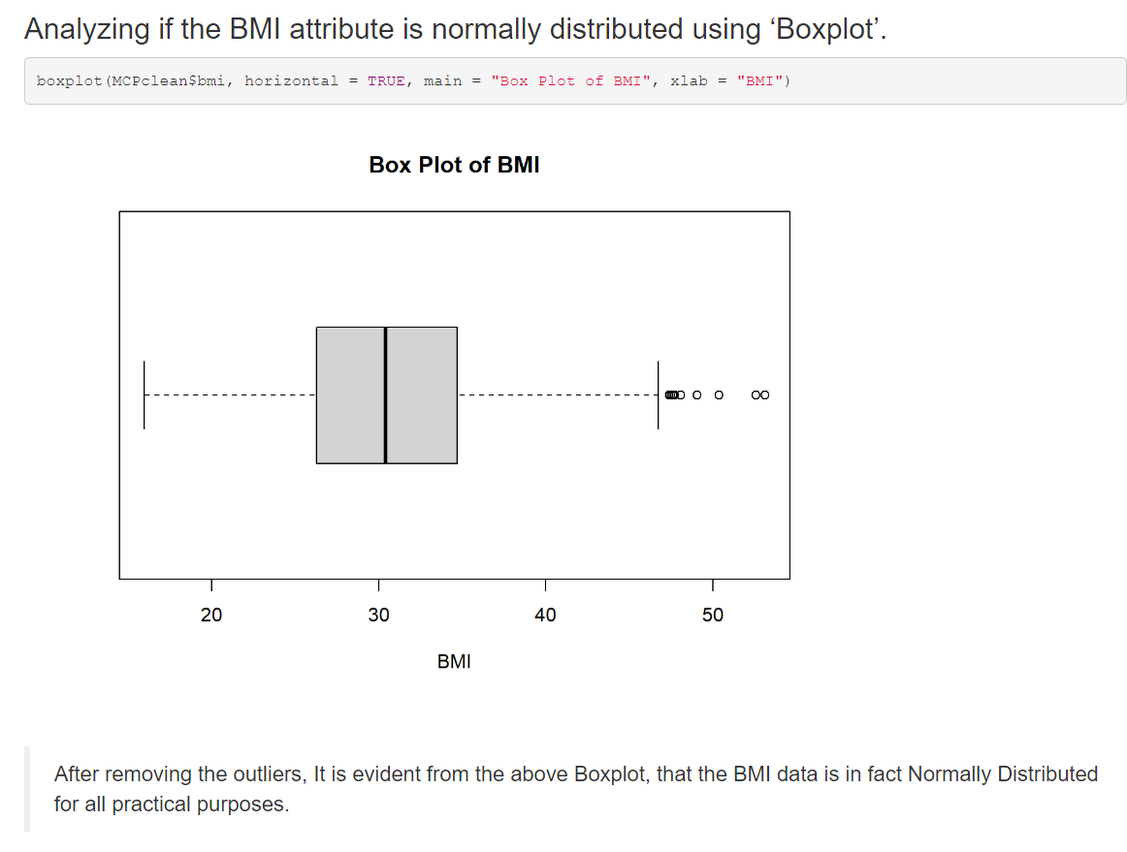
Analyzing BMI

Slide 22
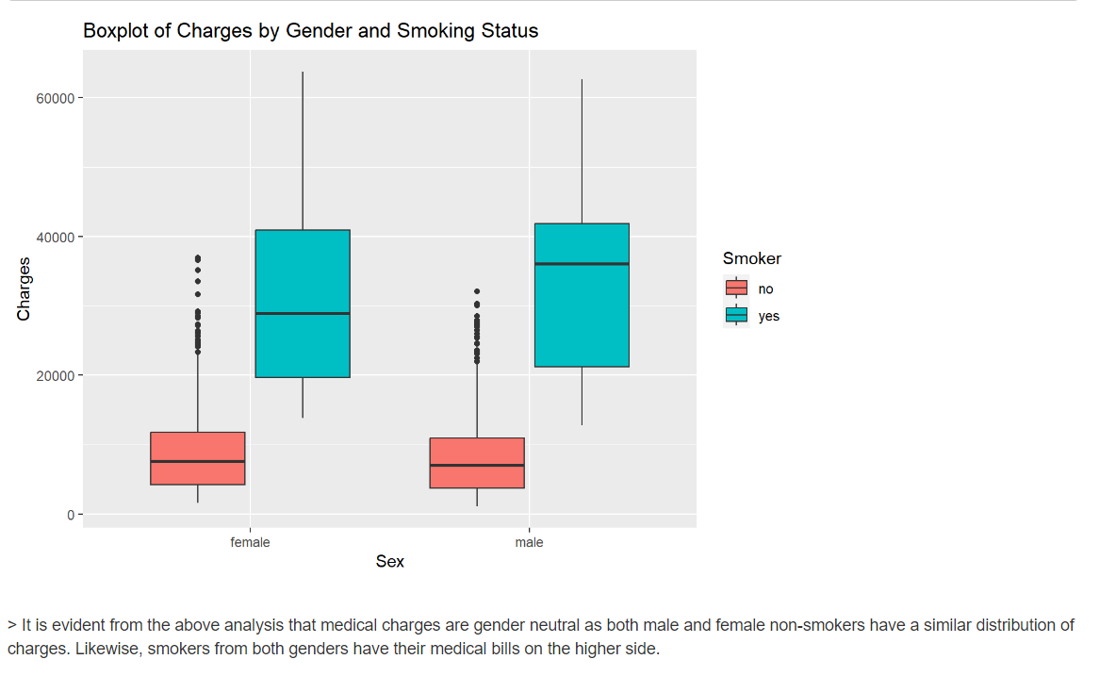
Boxplot of Charges

Slide 23
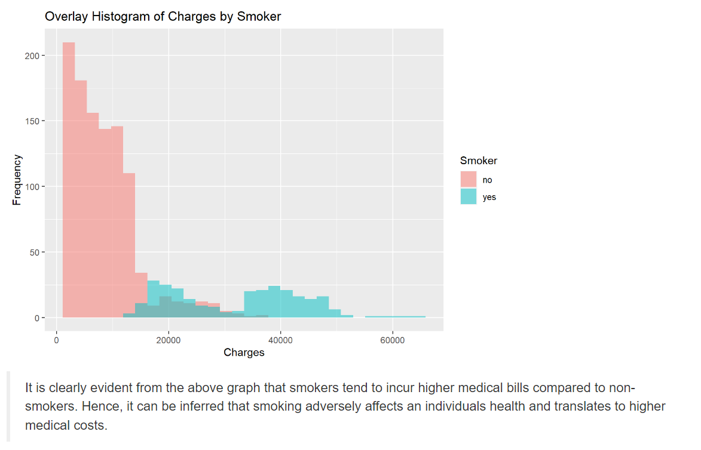
Overlay Histogram

Slide 24
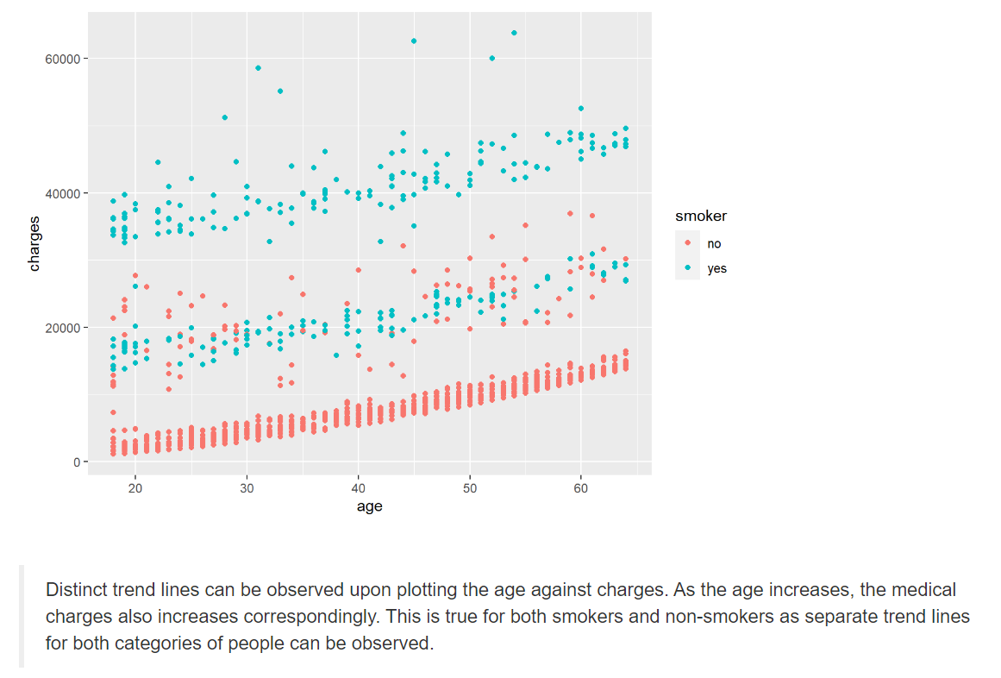
Relation b/w charges and age

Slide 25
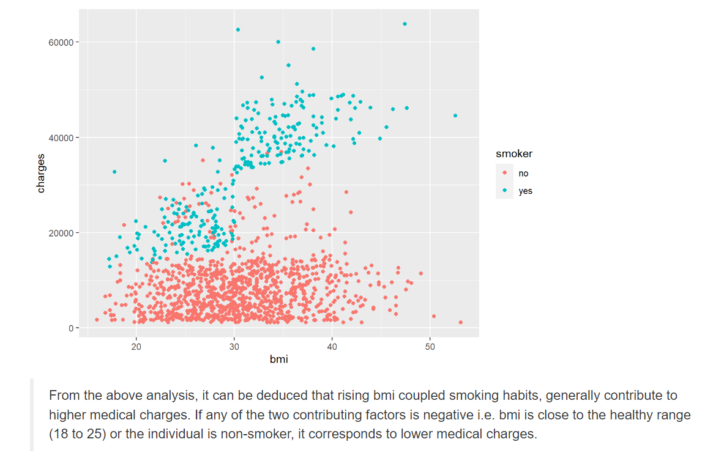
Relation b/w charges and BMI

Slide 26
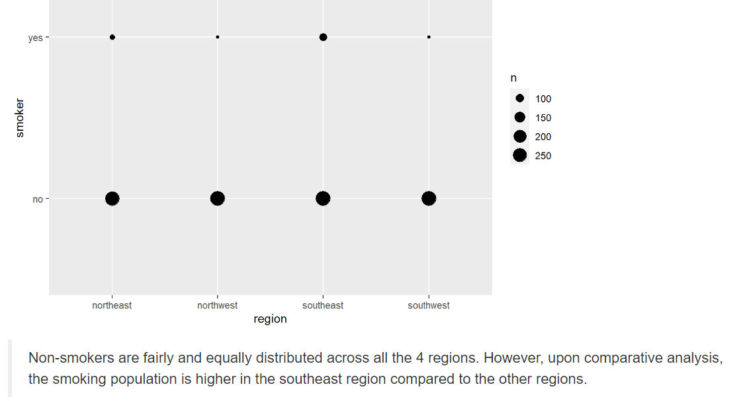
Smoker distribution across regions

Slide 27
Data Analysis

Slide 28

Hypothesis Testing
Comparing Variances (F Test)

Slide 29
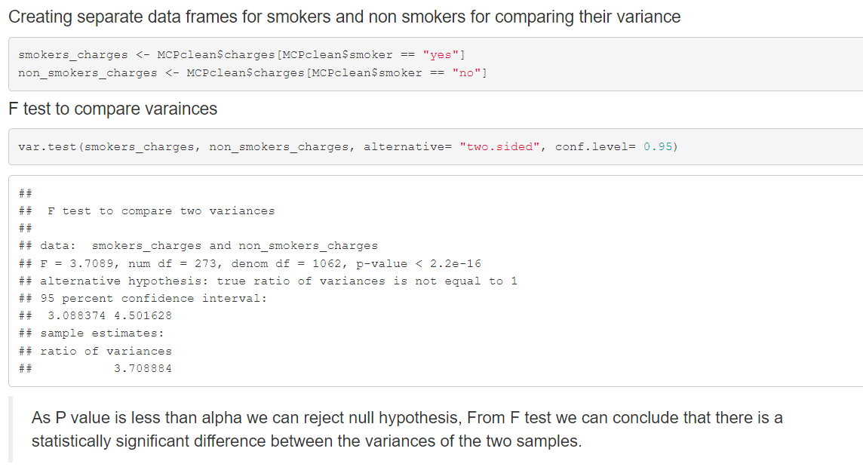
F Test

Slide 30
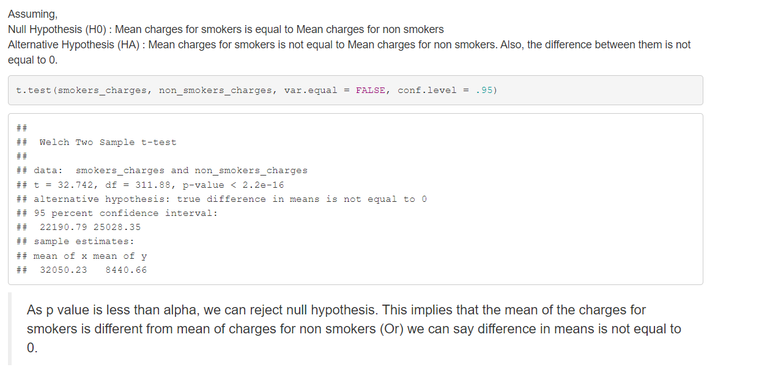
T test

Slide 31
Linear Regression (Refer pdf or RMD directly)

Slide 32

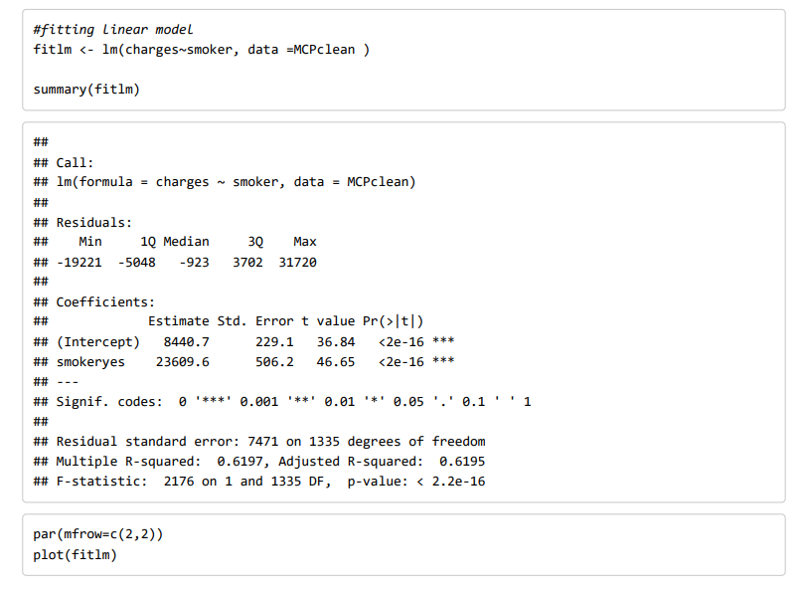

Slide 33
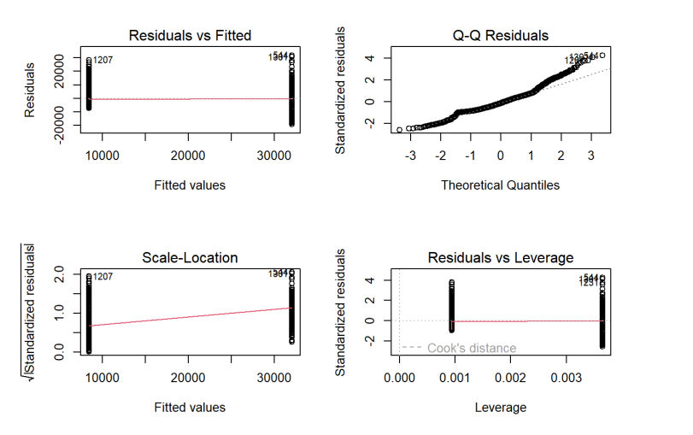

Slide 34
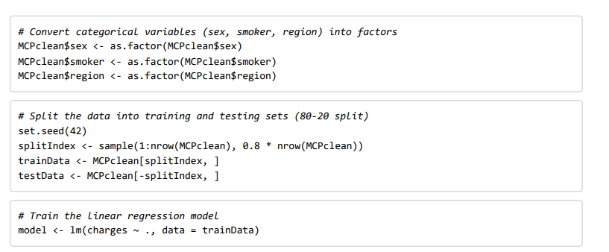

Slide 35
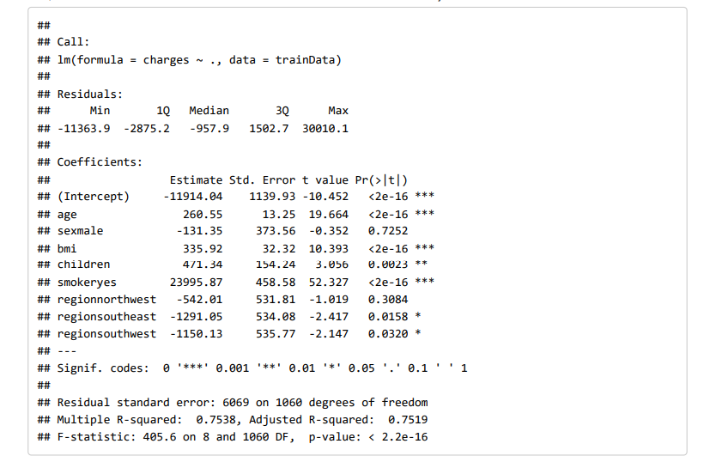

Slide 36
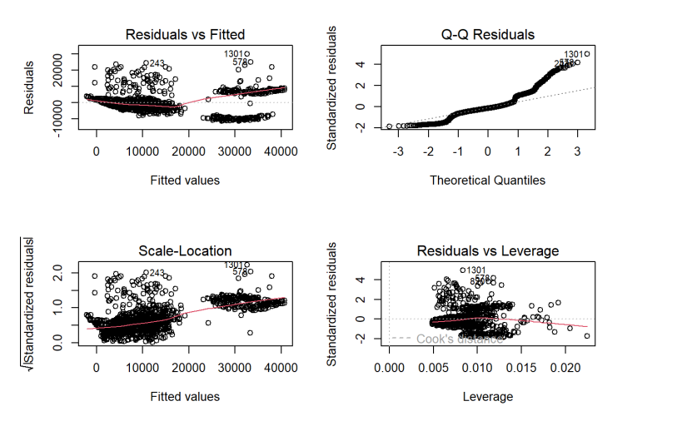

Slide 37
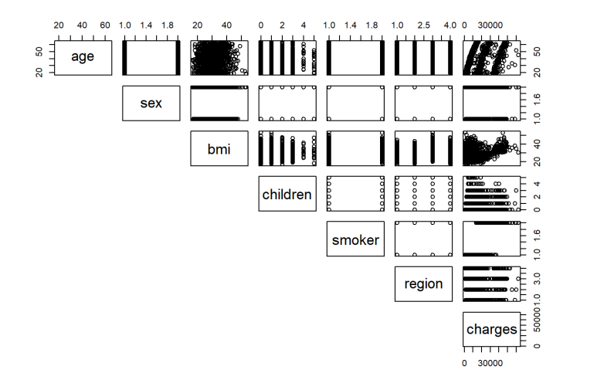

Slide 38
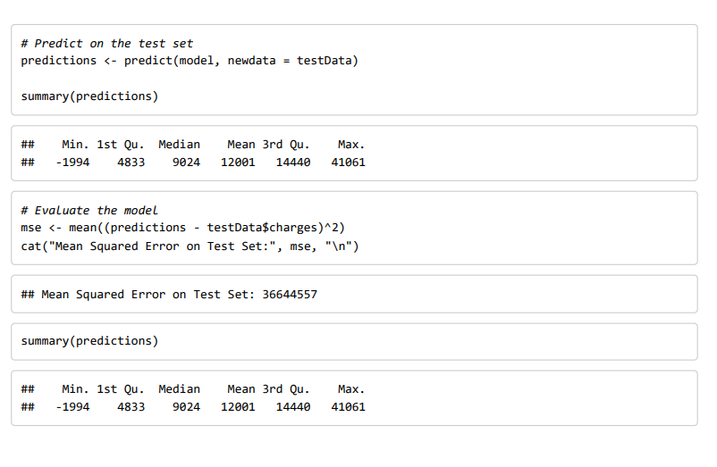

Slide 39
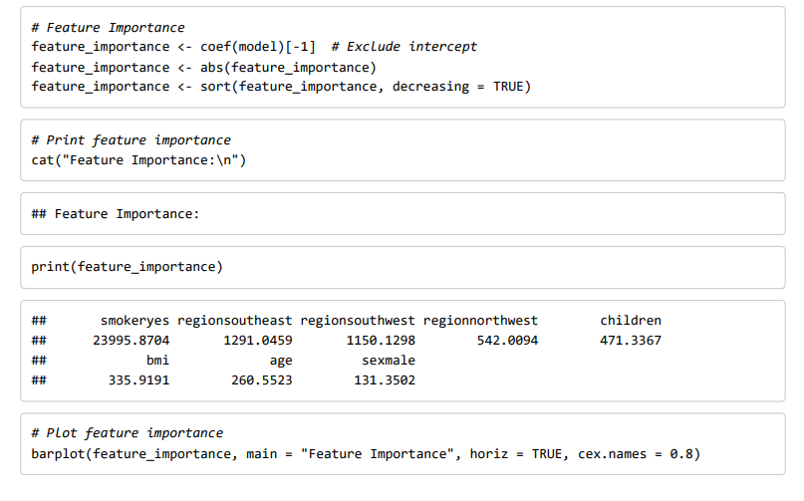

Slide 40
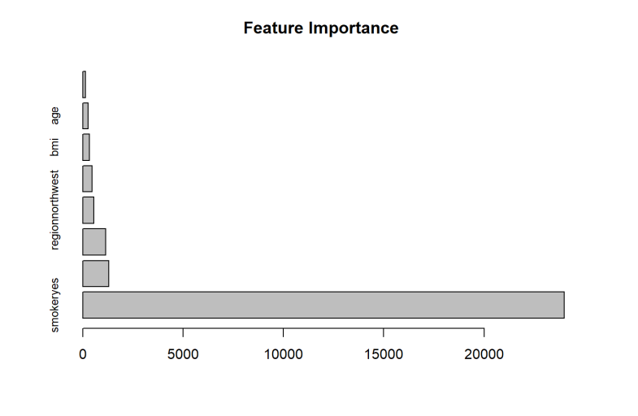

Slide 41
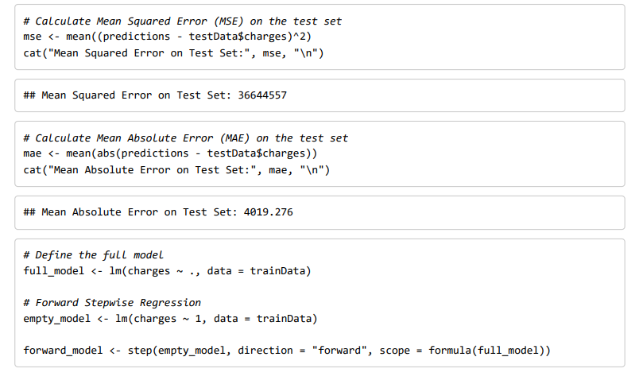

Slide 42
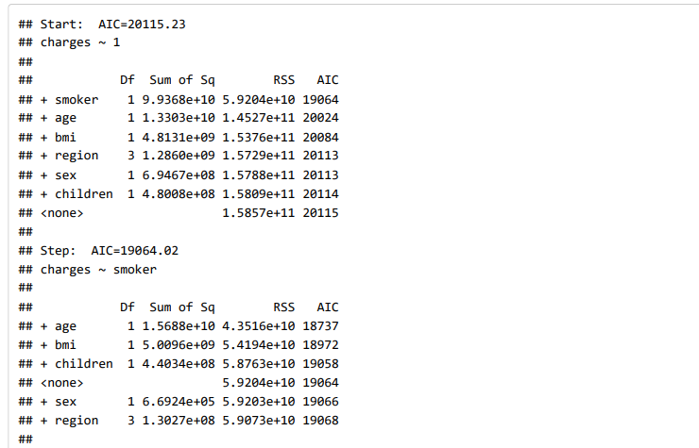

Slide 43
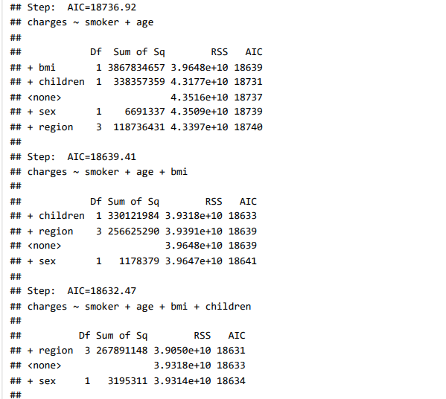

Slide 44



Slide 45



Slide 46
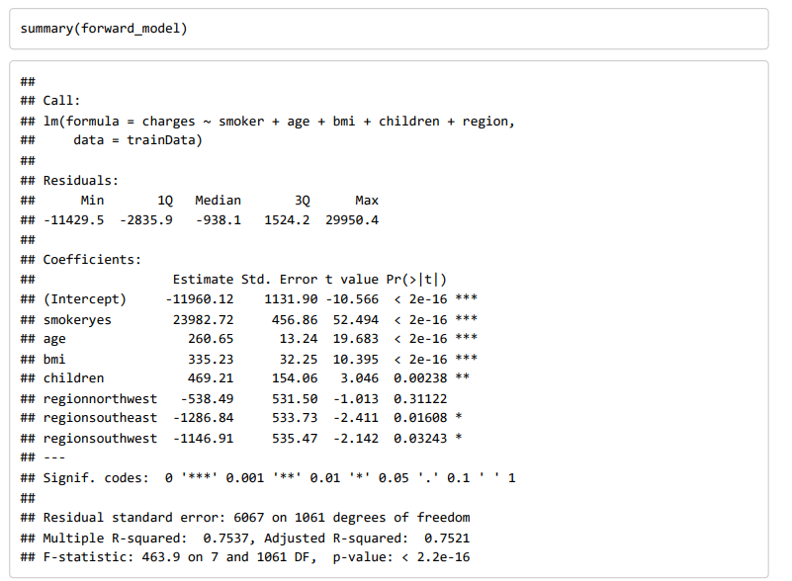

Slide 47

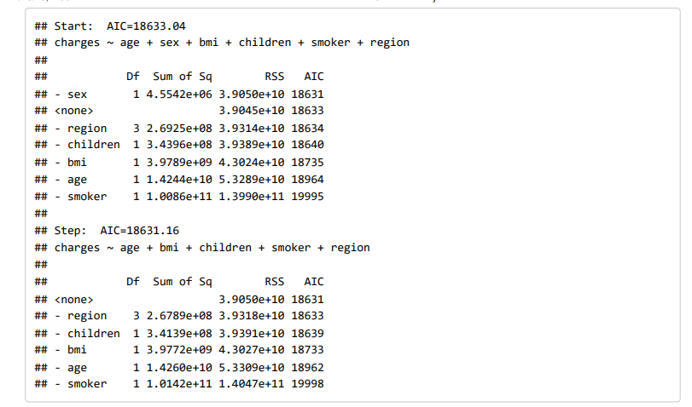

Slide 48
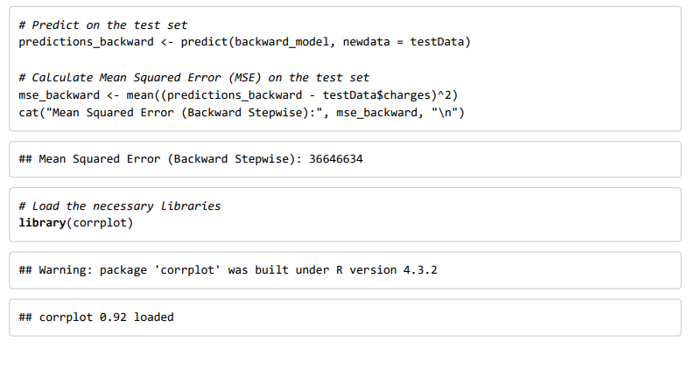


Slide 49
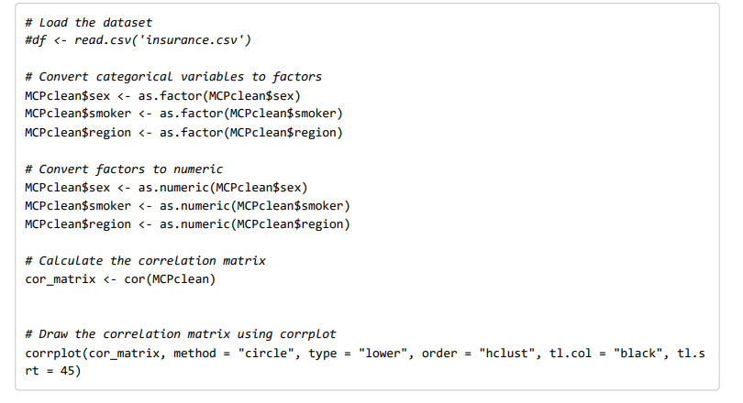

Slide 50
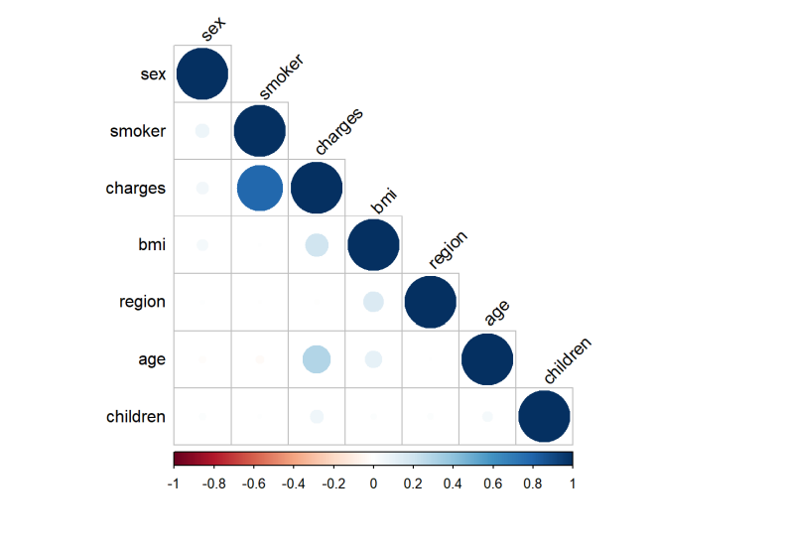

Slide 51
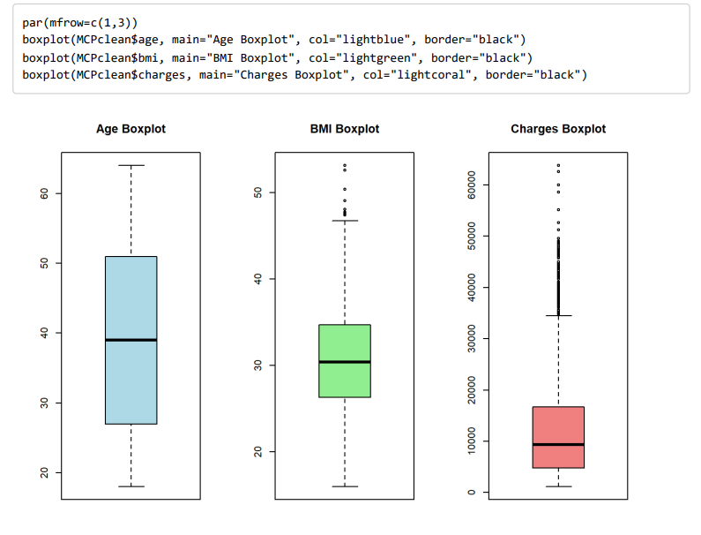

Slide 52

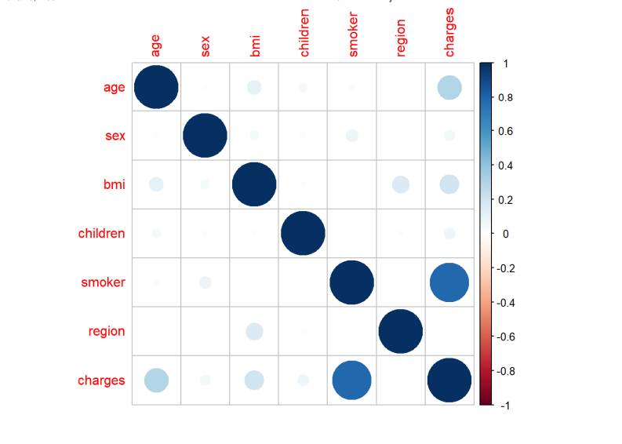

Slide 53
Thank You

